Slide 1
BJTU Weihai
Library Management System
MGIS.435.401 Team#8
Zhang, Lu
Zhang, Shuning
Zhao, Yumeng
Zhu, Xiaotong

Slide 2
PART 01 Project Overview
PART 02 ER Diagram
Table of
CONTENTS
PART 03 Forms, Reports, Dashboard
PART 04 App Demo
PART 05 Lessons learned & Future work

Slide 3
01
Project Overview

Slide 4
Project Overview
Necessitate
BJTU Weihai Library Management
A Database Application
Demands & Requirements…
For librarians:
Manage book categorization & book location
Manage suppliers
Manage users
For borrowers (both teachers & students):
Search book information
Borrow books
Return books
Can…
Enable effective management of books, suppliers & users for the librarians
Realize book querying, borrowing & returning processes more efficiently
Keep track of all the records for further analysis
Offer more insights for management
Empower

Slide 5

Project Overview
Book Circulation
Facilitate books borrowing, returning, renewing, and book dirty treatment
Query Management
User Management
Realize book information query, history borrowing records query, supplier information query, etc.
Input & record basic information about the borrowers/librarians;
Enable the viewing and update of user information
BJTUWH
Library System
Analysis
Book Cataloging
Generate reader/librarian-oriented reports;
Generate the library dashboard
Complete the book information input and pre-cataloging

Slide 6
02
ER Diagram

Slide 7
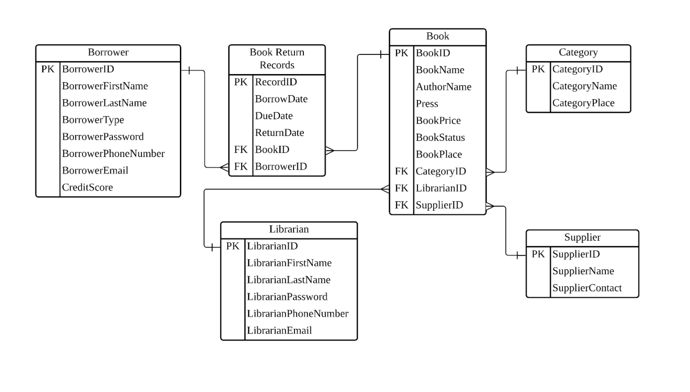
ER Diagram

Slide 8
03
Forms, Reports, Dashboard

Slide 9
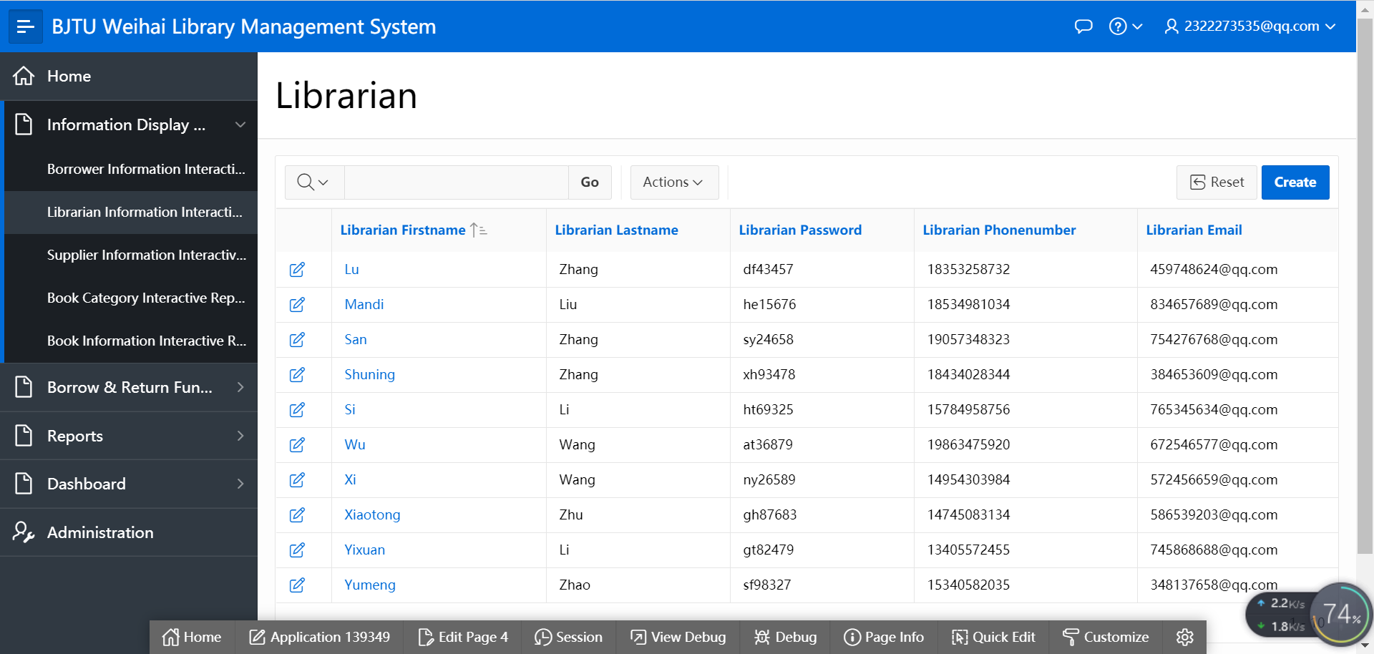
Forms

Slide 10
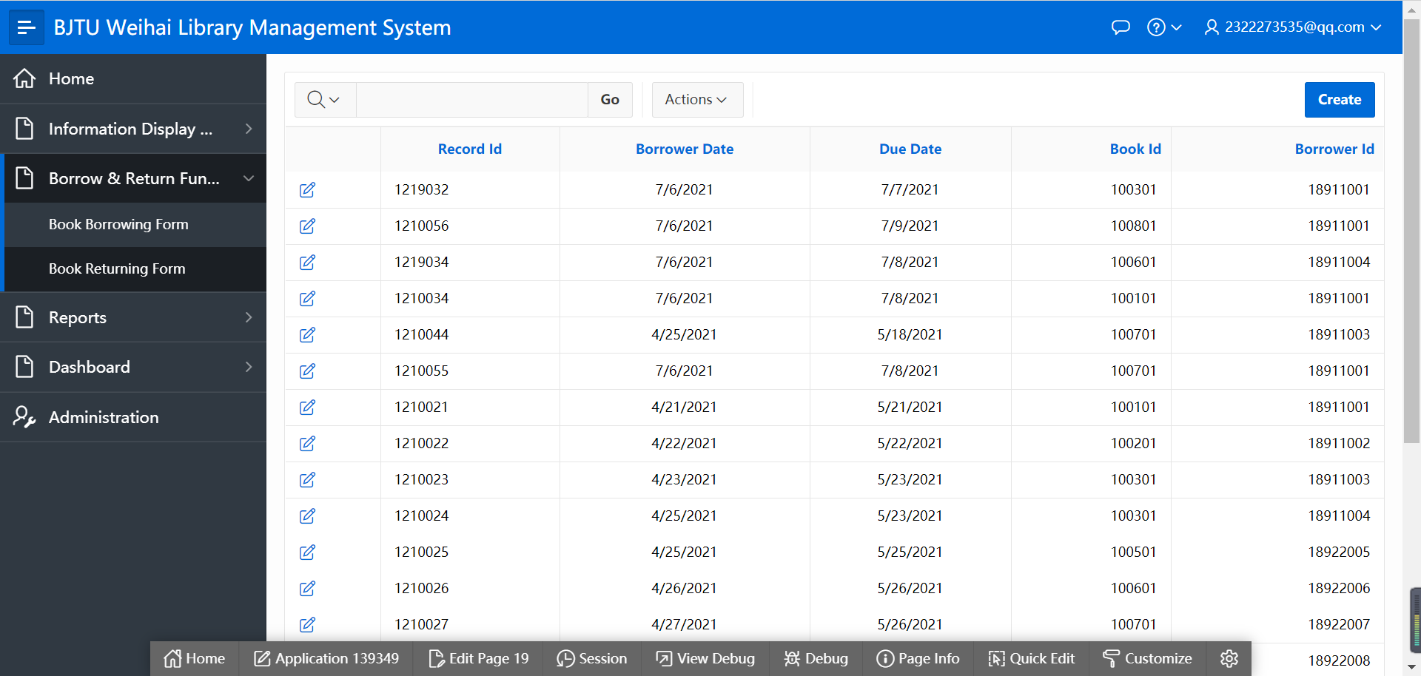
Forms

Slide 11
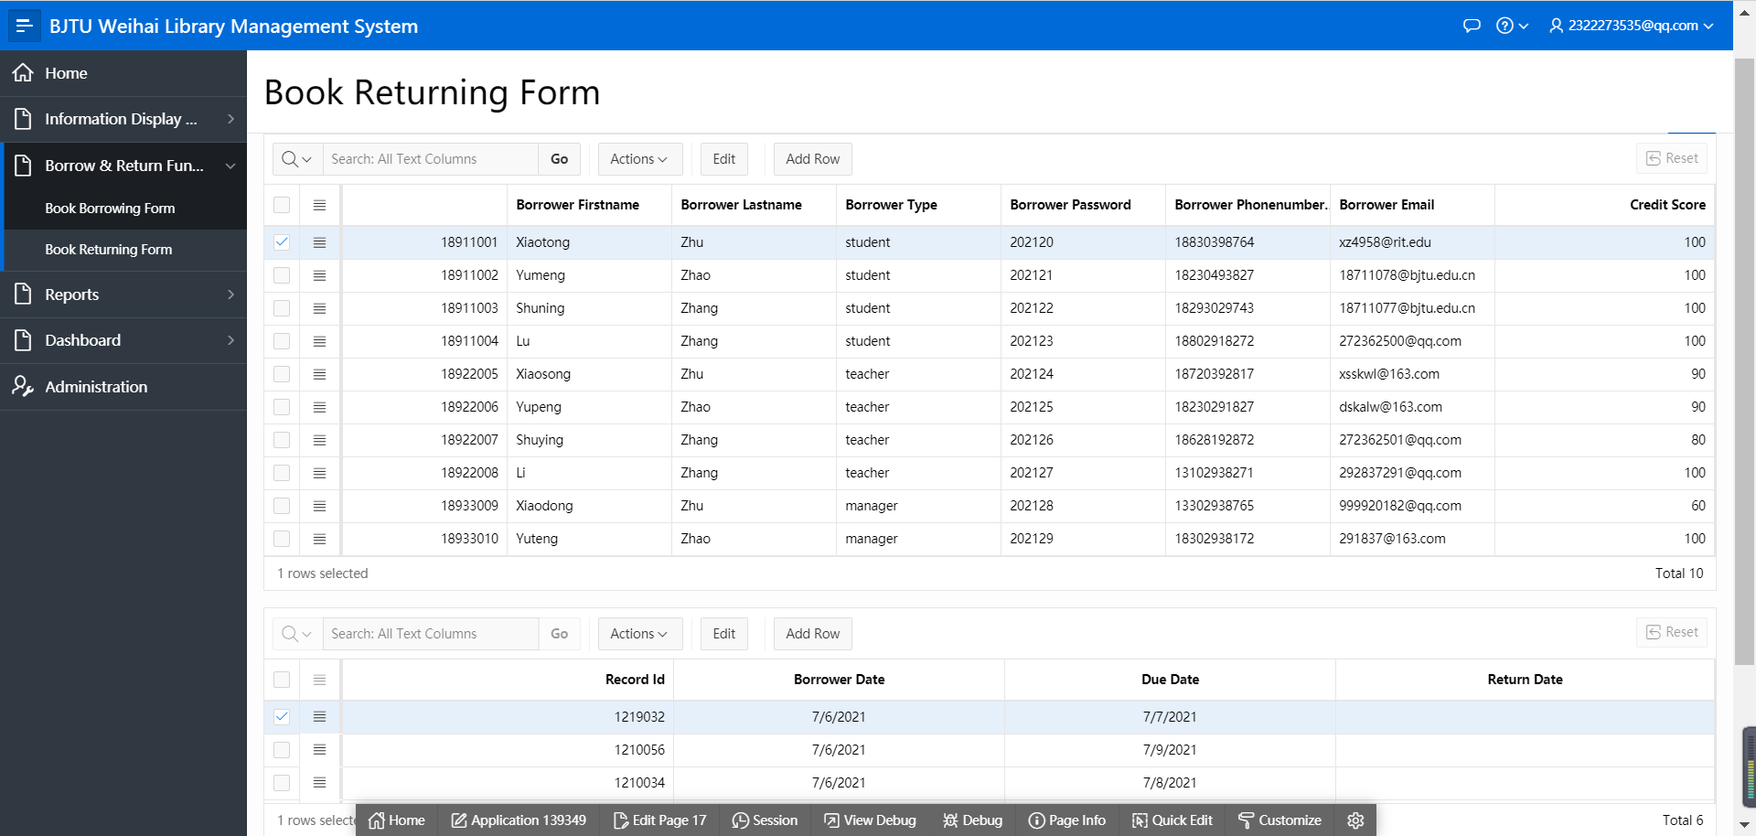
Forms

Slide 12
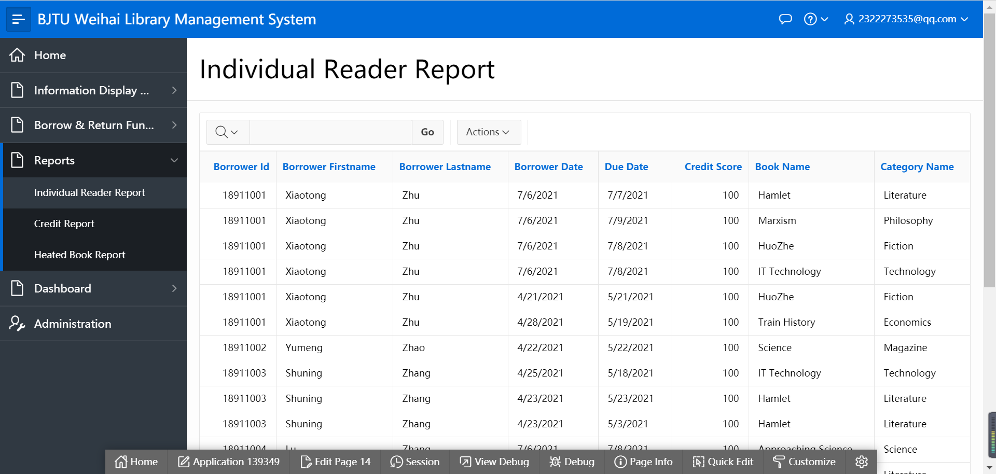
Reports

Slide 13
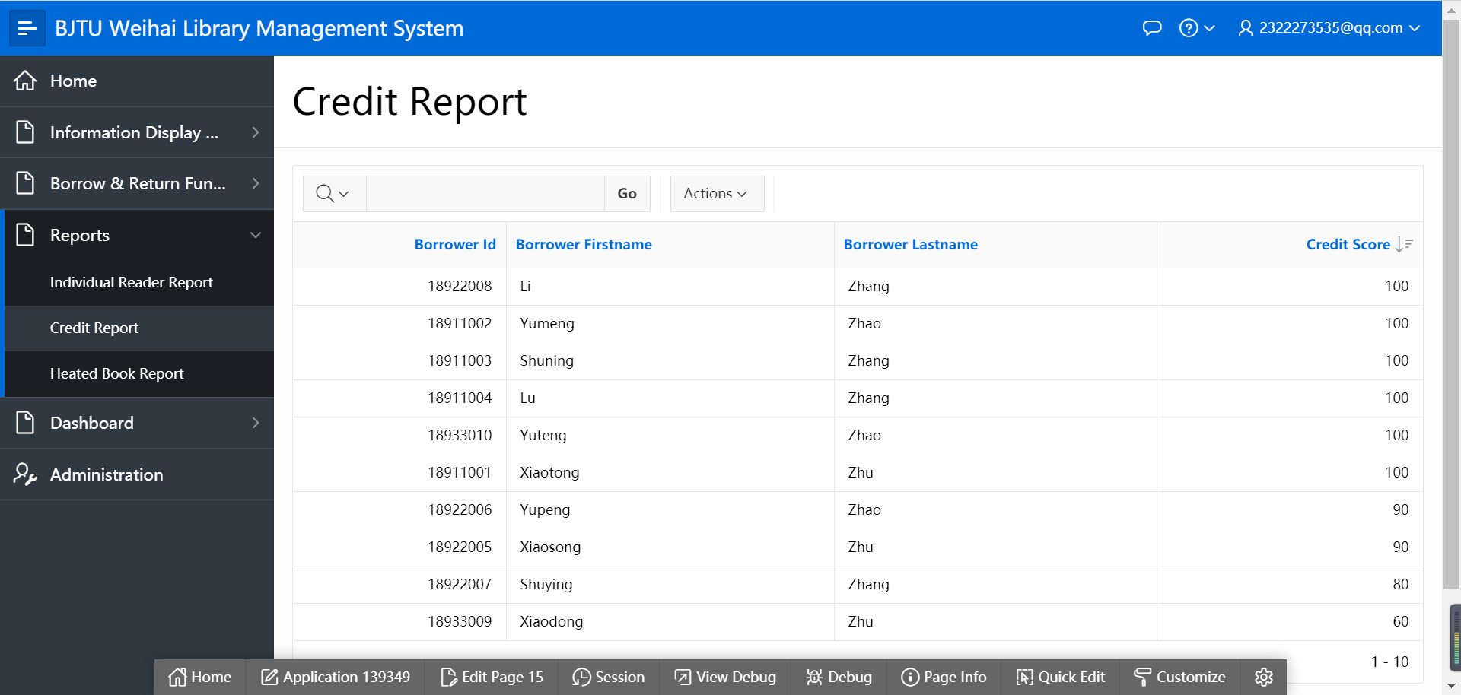
Reports

Slide 14
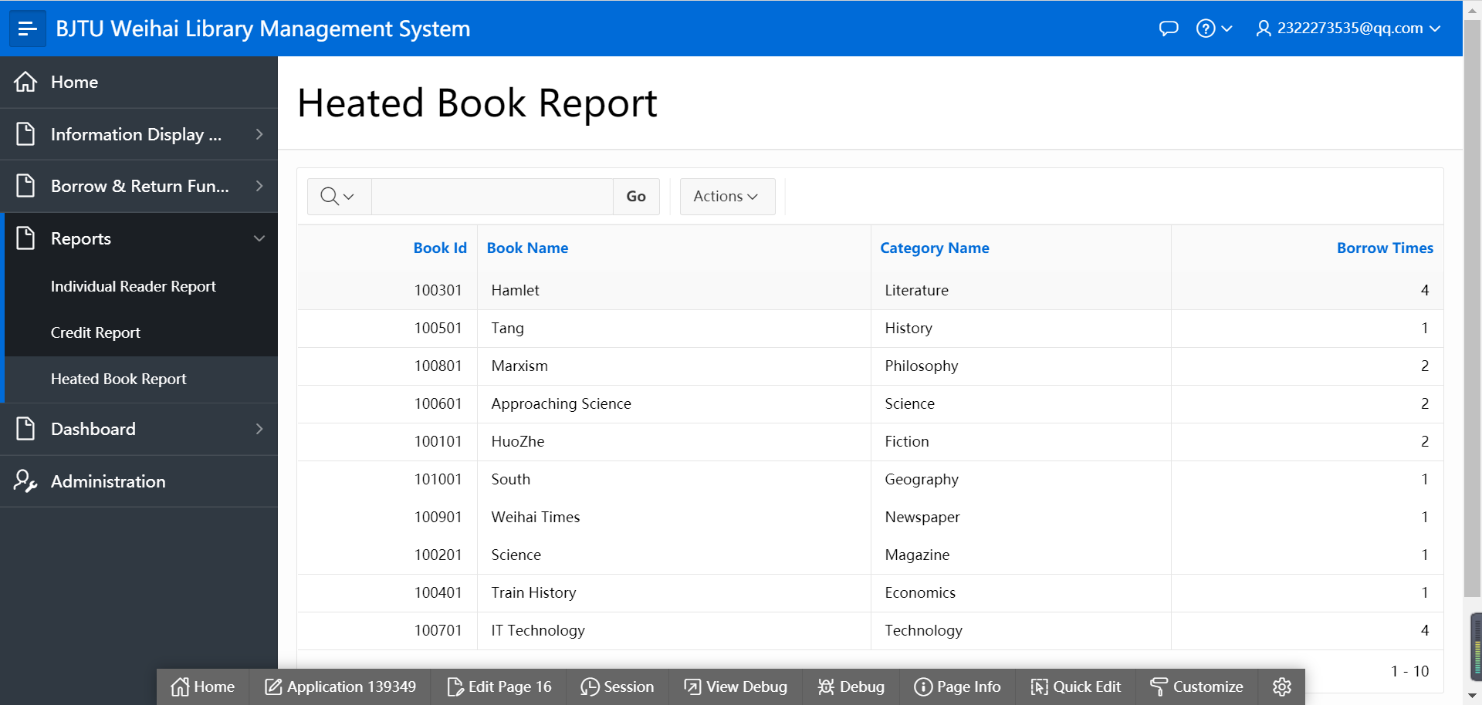
Reports

Slide 15
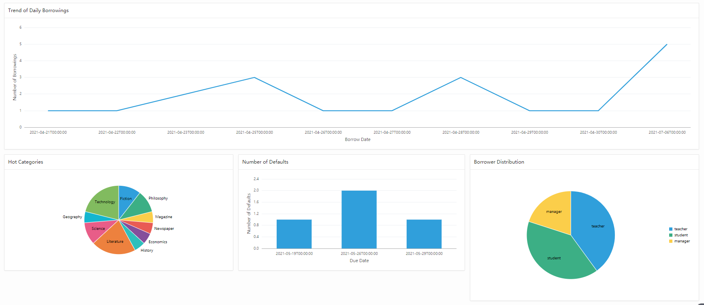
Dashboard

Slide 16
04
App Demo

Slide 17
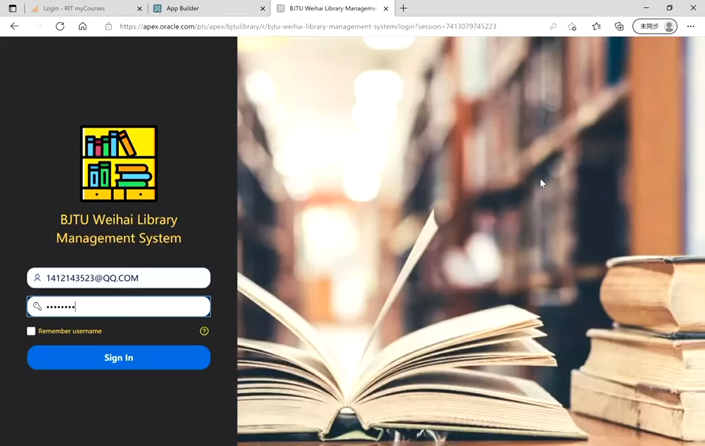
App Demo

Slide 18
05
Lessons Learned & Future Work

Slide 19
Lessons Learned
Step 01
Define the goals and functions of the system
Step 02
Plot the ERD
Step 03
Use SQL to create tables and insert data
Step 04
Apex application development

Slide 20

Future Work
SWOT
Not intelligent:
Automatically borrow and return books ×
Automatic credit score deduction ×
Automatically renew ×
Disadvantages
W

Slide 21


Future work
SWOT
Add book sales
Add book borrowing area
Opportunity
O

Slide 22
Future work
SWOT
T
Challenges
Automation:
Eliminate the record ID or create the record ID to be able to automatically input and fetch into the database.
Borrow books directly with their ID cards.
Try to write trigger conditions to realize automatic deduction.
Set up a renewal area in the section of book borrowing and returning.

Slide 23
Thank you

